Slide 1

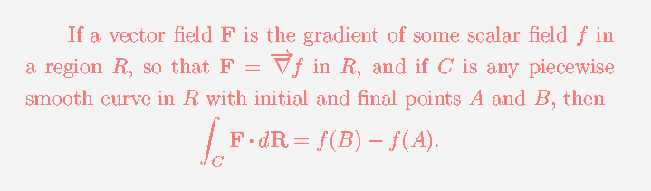

Slide 2
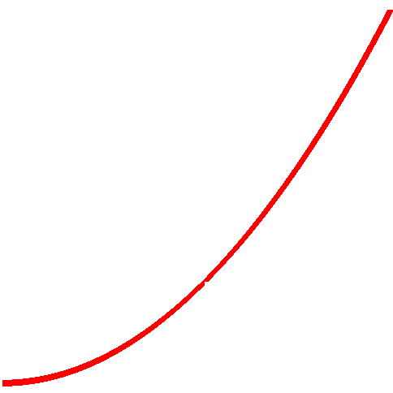
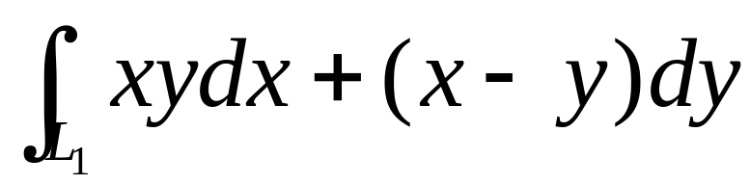



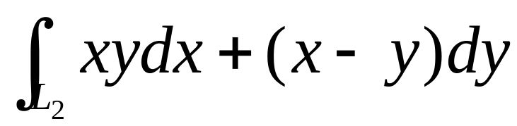
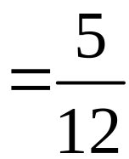


As seen before, the line integral usually depends on paths.
Example

Slide 3

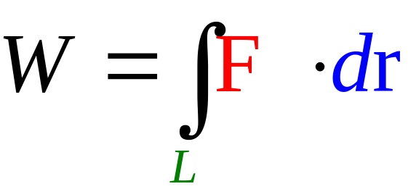


When path independence?
Conservative field（保守场）: the work done only depends on the initial and terminal points

Slide 4
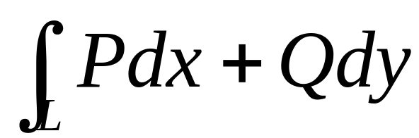
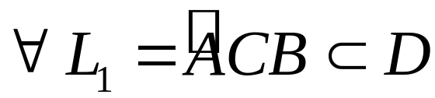


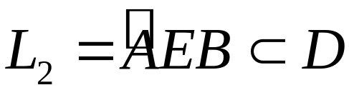

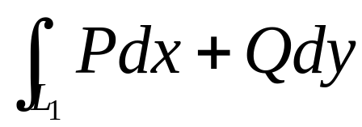
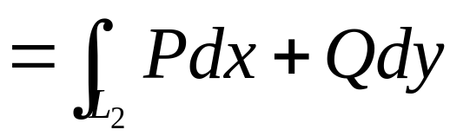
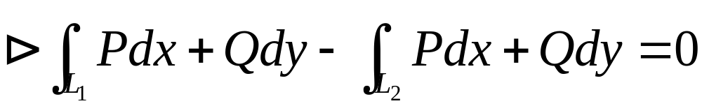
If independence,

Slide 5
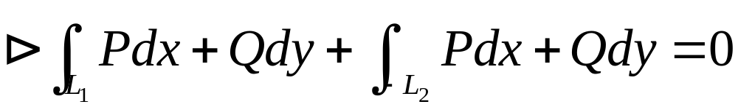
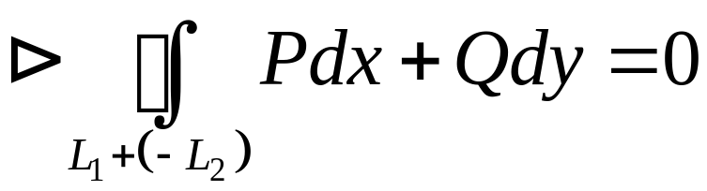

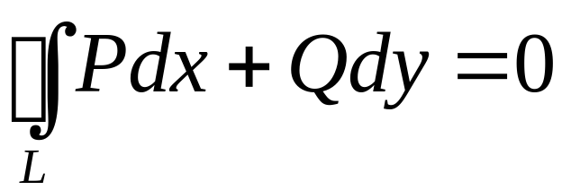
This means：
For each closed curve L in D，
We have

Slide 6
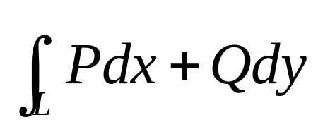
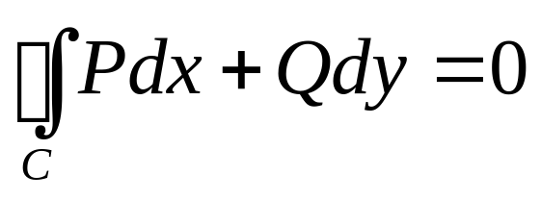
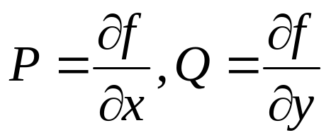
We now know that the line integral
is path independence, in D then
For any closed curve C in D.
We further prove that in this case, there is a function called potential function（势函数）
z=f(x, y) such that dz=Pdx+Qdy, in this case

Slide 7
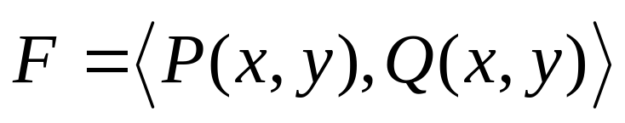
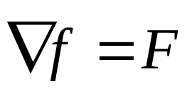
is called a potential field
(有势场) if
there is a potential function（势函数）
z=f(x, y) such that
（dz=Pdx+Qdy） ( )

Slide 8
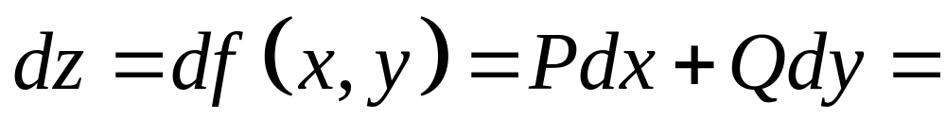
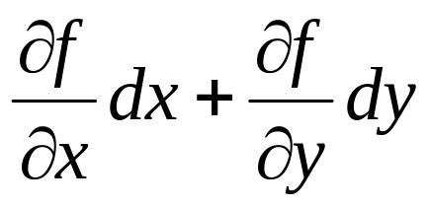
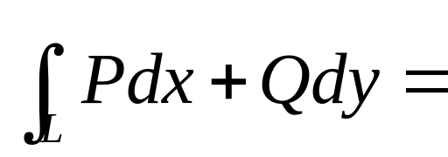
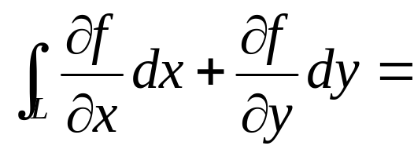
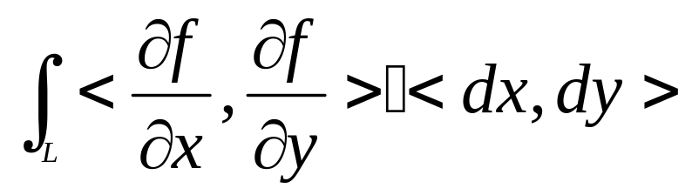
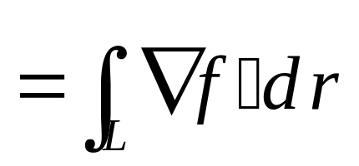
If
then

Slide 9
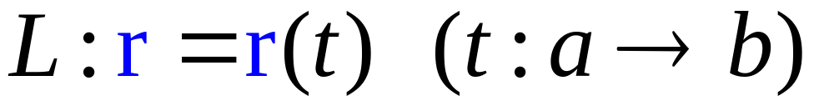
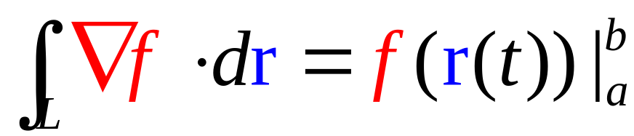
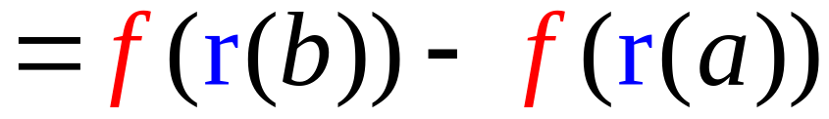
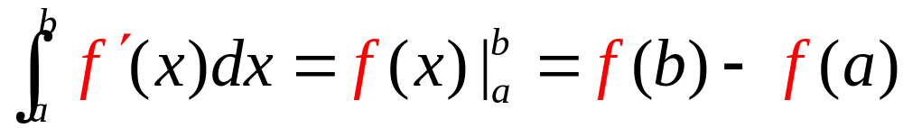
Theorem
The Fundamental Theorem for Line integrals
Similar to Newton-Leibniz theorem

Slide 10
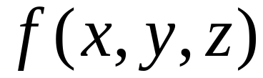
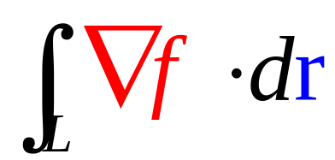
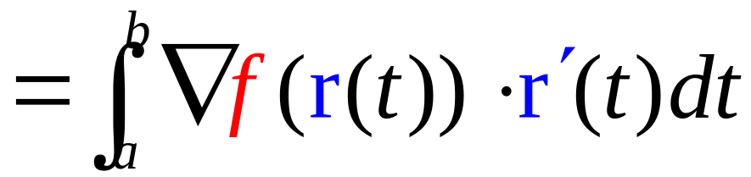
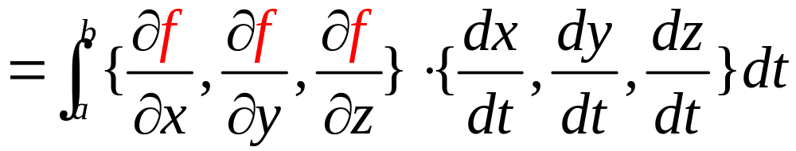
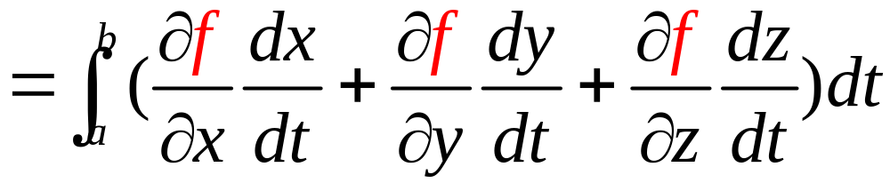
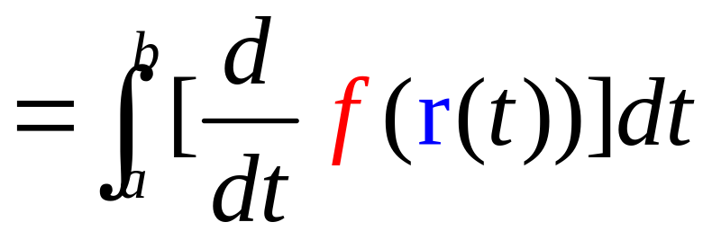
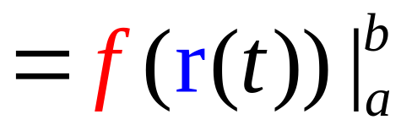
Pf.
suppose
is a function of three variables
Chain Rule
N-L theorem

Slide 11
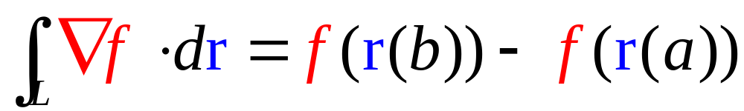
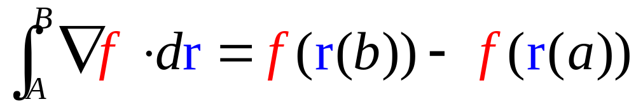
Means:
In this case, the line integral only depends on the initial and terminal points of the line L.
We could note this by

Slide 12
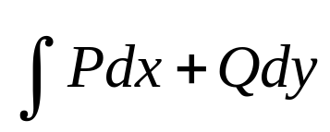
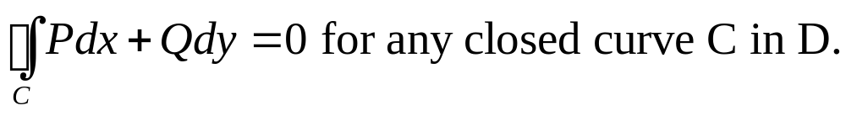
Summary: the line integral is path independence in D, then it is equivalent to that
OR there is a function z=f(x,y) such that dz=Pdx+Qdy
Whether or not it is easy to determine a given line integral is path independence in D?

Slide 13
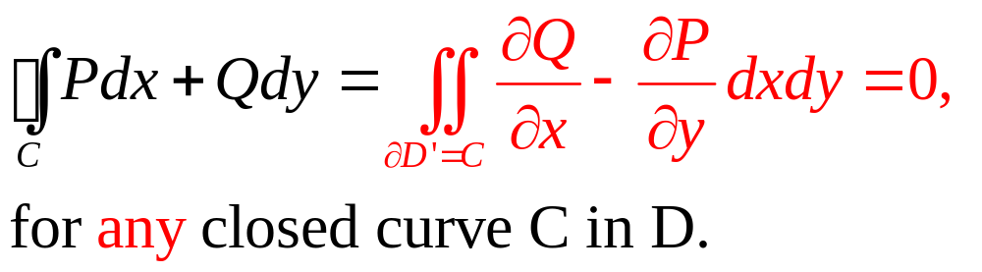
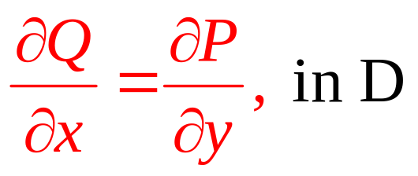
There is an easy way!! Let’s back to the Green’s theorem, if
Then
This means

Slide 14
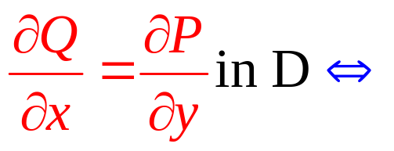
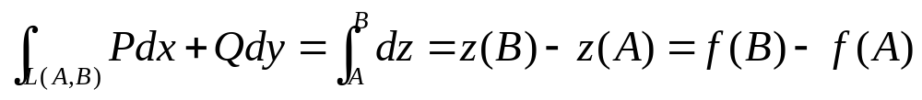

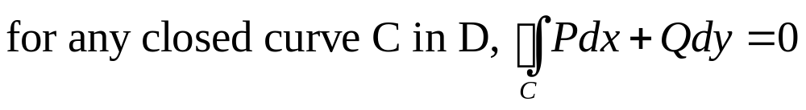

Unbelievable criteria:

Slide 15


当曲线积分
与路径无关时
我们可以不沿指定的 L 积分
一般选择沿折线积分

Slide 16
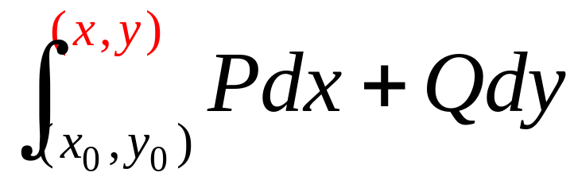













当曲线积分与路径无关时，
可沿平行于坐标轴的折线积分

Slide 17
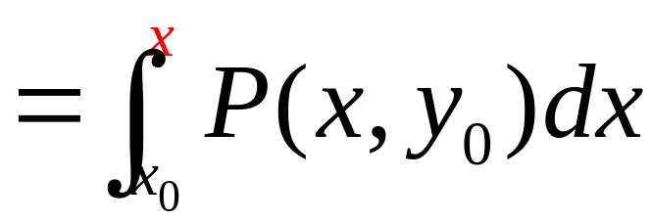
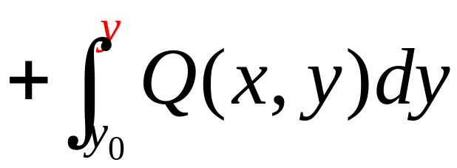

Slide 18
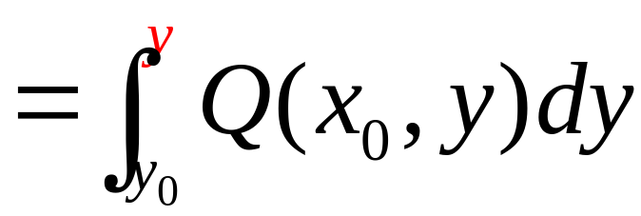


Slide 19

Example:
is not path independence since

Slide 20






Example
Solution
Hard if along L!!
Path independence, so
Choose another path!

Slide 21






Slide 22





Example: Finding potential functions
Solution
is the total differential of some functions f(x, y)

Slide 23








We can choose any point as the initial point,
So any function of the form
is a potential function.

Slide 24







An other way to find potential functions
The key is to find since

Slide 25






Slide 26


Potential function
Find
where

Slide 27
Theorem
The Fundamental Theorem for Line integrals

Slide 28

Exact Equations

Slide 29



如果微分方程
的左端恰好是某个函数 u(x, y) 的全微分：
Exactly
则称方程 (2.12) 为全微分方程
也称为恰当方程
Exact Equations

Slide 30



全微分方程
可以写成：
其通解：
在单连通区域内
是全微分方程的充要条件是：

Slide 31

求解步骤:
1. 求原函数 u (x, y)
方法1 凑微分法;
方法2 利用积分与路径无关的条件.
2. 由 d u = 0 知通解为 u (x, y) = C .

Slide 32



通解：
积分与路径无关 可沿折线积分
通解：

Slide 33











例
解方程：
解
类型？
不能分离变量
非齐次方程
非线性方程

Slide 34

这是全微分方程
方法一（凑微分法）

Slide 35







积分与路径无关
方法二

Slide 36

通解：

Slide 37

的方向场及积分曲线
with(DEtools):with(plots):
wffc:=(3*x^2*y(x)-3*x*y(x)^2+y(x)^2)*diff(y(x),x)=y(x)^3-5*x^4-3*x*y(x)^3:dsolve(wffc,implicit);
fangxiangcang:=DEplot(wffc,y(x),x=-1..1,y=-1..1,thickness=2):
jifenquxian:=contourplot(x^2-2*y^3/x,x=-1..1,y=-1..1,contours=20,color=blue,thickness=2):
display(fangxiangcang,jifenquxian);

Slide 38





的方向场及几条积分曲线
过点
with(DEtools):
DEplot(5*x^4+3*x*y(x)^3-y(x)^3+(3*x^2*y(x)-3*x*y(x)^2+y(x)^2)*diff(y(x),x)=0,y(x),x=-1..1,[[y(0.5)=0.1],[y(0.5)=0.3],[y(0.5)=0.6],[y(0.5)=0.8]],
y=-1..1,linecolor=[black,blue,red,brown],
color=violet,stepsize=0.01,scaling=constrained);

Slide 39
Exercise
解方程：

Slide 40




例
解方程：
解
类型？
不能分离变量
非齐次方程
非线性方程
贝努利方程！
什么方程？
积分难！

Slide 41



硬是有点恼火！
是不是全微分方程？
这也不是，那也不是！
怎么办？
也不是全微分方程
再看看：
等式两端乘以

Slide 42




与原方程同解？
基本上
好像等式两端都是全微分？
凑一下：
果然是全微分！

Slide 43

通解
方程乘以一个函数使方程成为全微分方程
称为积分因子
Integrating factor
这是一种解微分方程的方法
详略

